Slide 1

Recommendations to
Prevent Mental Health Conditions among Children and Adolescents in Massachusetts
Promote Prevent Special Legislative Commission
September 25, 2017
Danna Mauch, PhD
President and CEO
Massachusetts Association for Mental Health

Slide 2
Massachusetts Association for Mental Health
Mission and Vision
MAMH is committed to advancing mental health and well being by promoting prevention, early intervention, effective treatment and research to address social, emotional and mental health challenges.
Forging understanding and combating disparities since 1913

Slide 3
Overview
Importance of prevention for children and adolescents
Addressing disparities in prevention investments
Bringing evidence-based practices to scale
  Integrated Pediatric Primary Care - MYCHILD
  SOS Signs of Suicide
Summary of recommendations

Slide 4
Prevention and Early Intervention are Essential
1 out of 7
children, ages 2 to 8 years, were reported to have a diagnosed mental, behavioral, or developmental condition¹
Children with mental, behavioral, or developmental conditions were more likely to:
Have a parent who reported:
Fair or poor mental health
Trouble getting by on family’s income
Live in a neighborhood that:
Lacked support (neighbors didn’t watch out for each other)
Didn’t have amenities (like sidewalks or libraries)
Was in poor condition
The literature shows that early onset of these conditions in young children is related to a variety of problems in adolescence, including school drop out and justice involvement.²
¹Bitsko, Holbrook, et al., MMWR Morb Mortal Wkly Rep 2016;65:221–226. DOI: http://dx.doi.org/10.15585/mmwr.mm6509a1;
²Brauner, Stephens. Public Health Reports. 2006;121(3):303-310.

Slide 5
Prevention and Early Intervention are Essential
46%
of 13 to 18 year olds, either currently or at some point during their life, have had a mental health condition¹
21%
of 13 to 18 year olds, either currently or at some point during their life, have had a “severe” mental health condition²
Half
of children with mental health conditions, ages 8 to 15 years, did NOT receive treatment for their condition in the past year³
17%
of students in grades 9 through 12 in the U.S. seriously considered attempting suicide in the past 12 months
^{1,2}Available at: https://www.nimh.nih.gov/health/statistics/prevalence/any-disorder-among-children.shtml, “severe” requires survey respondents to report both distress and impairment; 3 Available at: https://www.nimh.nih.gov/health/statistics/prevalence/index.shtml;
⁴Available at: https://www.cdc.gov/violenceprevention/pdf/suicide-datasheet-a.pdf

Slide 6
Prevention and Early Intervention are Essential
Mental Health Concerns Start Early:
50% of all lifetime cases of diagnosable mental illness begin by age 14.
75% of begin by age 24¹
Parents often report concerns before age 5²
Those who exhibit symptoms at a young age are more likely to engage in risky behavior, which further increases risk
There Are Two Paths We Can Take:
Prevention/
Intervention
Increased Protective Factors
Increased likelihood of positive outcomes
Early signs and symptoms
NO prevention or intervention
Increased Risk Factors
Increased likelihood of negative outcomes
¹ Kessler, et al., 2005; ²National Research Council and Institute of Medicine, 2009

Slide 7
Disparities in Prevention Investments
The Commonwealth has placed increased emphasis on community-based prevention in recent reform efforts:
Patient-centered medical homes
Accountable care organizations
Prevention and Wellness Trust Fund
Pay For Success
However, investments of public dollars in substance abuse prevention remain very modest, and there is virtually no investment of public dollars in mental health prevention.

Slide 8

Disparities in Prevention Investments
Why is there so little public funding for mental health prevention?
BLOCK GRANTS
Community Mental Health Services
Block Grant
Substance Abuse Prevention and Treatment Block Grant
100% of award for services for adults with SMI and children with serious emotional disturbances.
No less than 20% of award dedicated to substance use primary prevention strategies.

Slide 9
Disparities in Prevention Investments
Recommendation:
Close the gap in public funding for mental health prevention services. Without adequate investment, there cannot be concerted mental health prevention programming here in Massachusetts.

Slide 10
Bringing Evidence-Based Practices to Scale
  There are evidence-based practices in mental health prevention that should be brought to scale.
  Investment in evidence-based practices is a prudent use of limited tax dollars and is a demonstration of fiduciary responsibility.
  Two examples targeting young children and adolescents:
  Integrated Pediatric Primary Care - MYCHILD
  SOS Signs of Suicide

Slide 11
Integrated Pediatric Primary Care
Mental health is the #1 medical expense for children in America.*
Early Childhood Mental Health (ECMH) Integration in Primary Care:
Reaching children and families early to optimize opportunity
Ignoring early childhood mental health is expensive
MYCHILD
Partnership – MA EOHHS, MA DPH, Boston Public Health Commission
Worked with Bowdoin Street Health Center, Health Care for the Homeless, Dorchester House, Charles River Community Health
Supported children, birth through first grade, and their families
* SOURCE: AHRQ 2009.

Slide 12
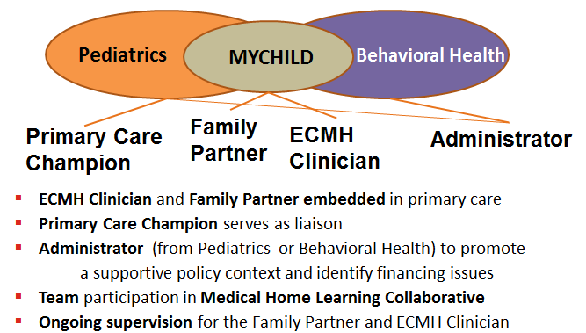
MYCHILD – Introduction and Model

Slide 13
MYCHILD – Evaluation Results Summary
Significant, positive outcomes for both children and adults
As measured by evidence-based tools, MYCHILD resulted in statistically significant:
Reduced levels of parenting stress and depression symptoms
Improved child mental health and social emotional wellness
Lower cost of care
Medicaid data was used to compare MYCHILD children with a matched group:
MYCHILD children had a lower cost of care on average per month; MYCHILD costs were $164.21 less per child per month vs. controls
MYCHILD children were more likely to receive appropriate, non-stigmatizing diagnoses
Notes:
Average cost per child per month includes ALL MassHealth costs for the child. Follow-up period was one year following the index date.

Slide 14
MYCHILD Family Outcomes: Parental Stress Index
Notes:
There was a statistically significant difference in the change in Total Problem t-scores between the two groups of children, those in the clinical concern and non-clinical concern range at baseline.
Children in the clinical concern group experienced a decrease in behavioral problems to the clinical limit at six-month follow-up, but their Total Problem scores rose slightly above the clinical limit at 12-month follow-up interview. The non-clinical concern group noticed a slight gradual decline in their total problems scores, overall.

Slide 15
MYCHILD Child Outcomes: Child Behavioral Checklist

Slide 16

MYCHILD – Family Story
A Parent’s Perspective
In my family, disciplining was hitting and screaming. I didn’t want that for my kids…
I learned how to think for myself, how to help myself, how to be a better mom and understand my children. I have the relationship with my kids now that I always wanted to have with my parents and never had when I was growing up.

Slide 17

Integrated Pediatric Primary Care –
Building a body of knowledge
MetroWest Health Foundation
Investing in early childhood mental health integration in primary care
Grantee: Southborough Medical Group and Advocates
Outcomes (July - December 2016):
Improved access to behavioral health services
  Timeliness: Increase in the number of patients seen on the same day as the referral from the pediatrician
  Engagement: 81% of patients with an initial behavioral health evaluation attended their second appointment
Addressed language and cultural barriers to care
Improved communication between patients and providers on behavioral health and social concerns

Slide 18
Integrated Pediatric Primary Care –
Recommendations
Recommendations:
Build on progress in our state: Every child on MassHealth gets screened at well child visits, but pediatricians don’t necessarily know what to do or have the resources to act on the results
Support implementation of the model beyond the pilot sites, providing better care at lower cost
Move beyond pilot efforts and fund a system that integrates early childhood mental health prevention and promotion activities into current practices
Normalize the medical home as a place to turn for support with challenges to child emotional health

Slide 19
Signs of Suicide (SOS): Program Description
School-Based Suicide Prevention Program for Middle and High School Students
Curriculum:
Administered through video and discussion
Promotes concept that suicide is directly related to mental illness
Students taught to recognize the signs of suicide in themselves and others
Taught to:
A Acknowledge
C Care
T Tell
Screening:
Every student completes the Columbia Depression Scale
Students self-assess and then are encouraged to seek help
They are provided an inventory of the resources available if they would like to seek help.

Slide 20
Signs of Suicide (SOS): Evidence Base
SOS is an Evidence-Based Practice that has been proven effective in replicated studies
Students who receive the intervention are 64% less likely to attempt suicide
SOS training leads to greater knowledge of depression and suicide
SOS training leads to a greater likelihood of intervening with friends and family who may be exhibiting signs of suicidal intent and of seeking help for themselves
64%

Slide 21
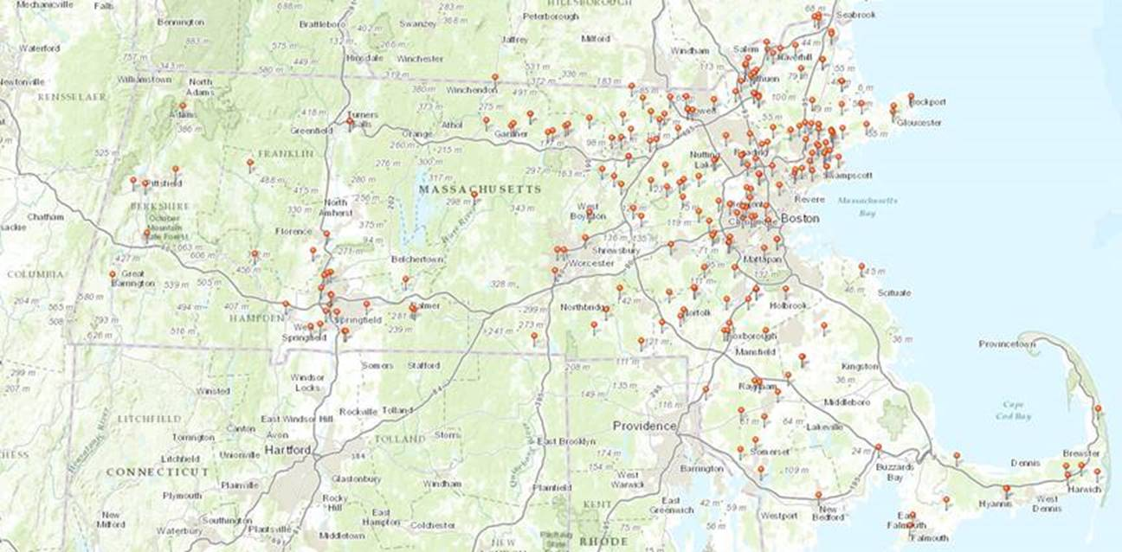
Signs of Suicide: Building Blocks
SOS has already been adopted by school districts across the state and has received funding from multiple foundations

Slide 22
Signs of Suicide: Building Blocks
Recommendations:
Support implementation of the SOS model in schools across Massachusetts
Fund universal adoption of SOS in every middle and high school in Massachusetts

Slide 23
Recommendations - Summary
Summary of Recommendations:
Start promotion and prevention early to optimize opportunity
Close the gap in funding for mental health prevention
Invest in universal adoption of evidence-based practices in mental health promotion and prevention
Thank you:
Jessica Larochelle, MPH
Director of Public Policy and Government Relations
Genevieve Mulligan, BA
Policy Research Associate
Danna Mauch, PhD
President and CEO
dannamauch@mamh.org

