Slide 1


Slide 2
Objectives:
Discuss the importance of creating accessible treatment for young people who use substances
Describe screening tool (S2BI) and appropriate interventions based on results
Provide an overview of resources available for treatment

Slide 3
Important Points
The adolescent brain is highly sensitive during this developmental period increasing susceptibility to developing a substance use disorder (SUD)
Even for those who don’t develop an SUD, adolescent substance use significantly increases risks for death, injury or other physical and mental health problems for this age group

Slide 4
Adolescent Substance Use and Treatment
1.8 million adolescents ages 12-17 were diagnosed with a past year SUD
Only 19.3% of those diagnosed received treatment
Substance Abuse and Mental Health Services Administration. (2024). 2023 National Survey on Drug Use and Health: Main highlights (HHS Publication No. PEP24-07-01-006). U.S. Department of Health and Human Services. https://www.samhsa.gov/data/sites/default/files/NSDUH%202023%20Annual%20Release/2023-nsduh-main-highlights.pdf
Notes:
Source: Substance Abuse and Mental Health Services Administration. (2020). Key substance use and mental health indicators in the United States: Results from the 2019 National Survey on Drug Use and Health (HHS Publication No. PEP20-07-01-001, NSDUH Series H-55). Rockville, MD: Center for Behavioral Health Statistics and Quality, Substance Abuse and Mental Health Services Administration. Retrieved from https://www.samhsa.gov/data/
During 2019 in the U.S:
4.5% of adolescents ages 12-17 were diagnosed with a past year SUD
8.3% of adolescents ages 12-17 were diagnosed with a past year SUD received treatment
0.7% of (all) adolescents ages 12-17 received any SUD treatment

Slide 5
How can we intervene?

Slide 6
Screening
Universal or targeted screening for assessing use and severity of tobacco/nicotine; alcohol; illicit drugs; and prescription drug use and disorders

Slide 7
Top Reasons for Not Screening
No Time
No Training
Tenacious Parent (won’t leave the room)
Need to Triage Competing problems
Not familiar with screening
Perceived lack of treatment

Slide 8
Comparison of Provider Impressions with Diagnostic Interview
 | Medical Provider Impressions
 | Sensitivity | Specificity
Any use | .63 (.58, .69 CI) | .81 (.76, .85 CI)
Any problem | .14 (.10, .20 CI) | 1.0 (.99, 1.0 CI)
Any disorder | .10 (.04, .17 CI) | 1.0 (.99, 1.0 CI)
Dependence | 0.0 | 1.0
Source: Wilson CR, Sherritt L, Gates E, Knight JR. Are clinical impressions of adolescent substance use accurate? Pediatrics, 2004;114:536-540
Notes:
8
This was a study done many years ago that focused on measuring the accuracy of medical provider impressions based on their own interview of patient (using their own questions in their own word) versus using a structured diagnostic interview. Bottom line, provider impressions were woefully inadequate.
63% of medical providers could identify that the adolescent patient had used some substance (likely because the patient admitted it)
14% identified any “problem” associated with substance use
10% identified that there might be a disorder
None were able to accurately identify the presence of a severe substance use disorder (this study was done before 2013, so before the DSM changed SUD categories – we keep the terms used at the time to ensure fidelity)

Slide 9
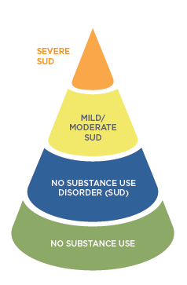
Notes:
There is a spectrum of substance use starting with no use (which most adolescents fall in the category of) and moving on up with the fewest number of adolescents falling the in the Severe SUD category.
I like to point out that only 10% of adolescent who use substances go on to develop an SUD. While this may lead people to think that we really only need to intervene when substance use reaches a disordered level, they are missing important opportunities for early intervention. We don’t know who will and won’t develop an SUD. And further, while 90% of adolescents who use substances will not develop others will have significant and sometimes long-term impacts to their physical and mental health because of substance use.

Slide 10
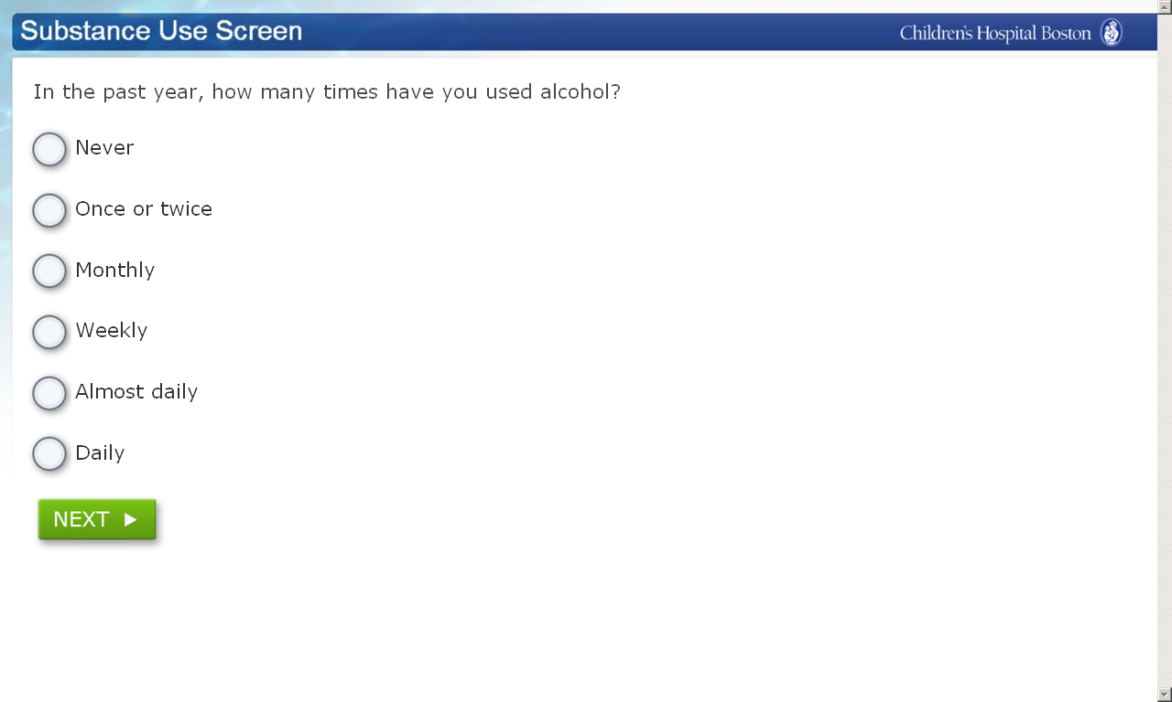
Screening to Brief Intervention (S2BI) In the past year, how many times have you used
Tobacco/Nicotine? (such as cigarettes, e-cigarettes, “vapes”)? Alcohol? Marijuana? STOP if all “Never.” Otherwise, CONTINUE. Prescription drugs that were not prescribed for you (such as pain medication or Adderall)? Illegal drugs (such as cocaine or Ecstasy)? Inhalants (such as nitrous oxide)? Herbs or synthetic drugs (such as salvia, "K2", or bath salts)?
Notes:
Screen to Brief Intervention (S2BI) – validated and reliable screening tool for young people ages 12-17 (we still use it for older adolescents and young adults but modify intervention based on age and legality of substance – it is really just a prompt to ask more questions of this age group to assess if there is concern about their level of use)
You ask the same question for each substance shown on the bulleted list:
“In the past year, how many times have you used tobacco/nicotine?”
“In the past year, how many times have you used alcohol?”
And so on. The patient answers using one of the frequency answers: Never, Once or twice, Monthly, Weekly
(There is a more accurate version of what this looks like on the next slide)
If they answer never to the top three bullets, they don’t need to continue the screen. The large majority of young people use the top three substances. It is highly unlikely that if they say never to the top three, so to be most efficient, you can stop the screen at that point. (Personal Reference: I have only ever had one patient in 16 years who used one of the bottom substances but had never used one of the top substances.)
A few good points to make:
The questions should be asked as they are written – that is what makes it a valid and reliable tool
The wording on the question “how many times have you ever” has been shown to elicit more accurate answers as the assumption that may have used any substance reduces the feelings of shame and stigma
Yes, patients may choose not to disclose their use with accuracy, so there is always a bit of “take it with the grain of salt”, but we can only do what we can do. For those who do accurately report, the results are highly reliable.

Slide 11
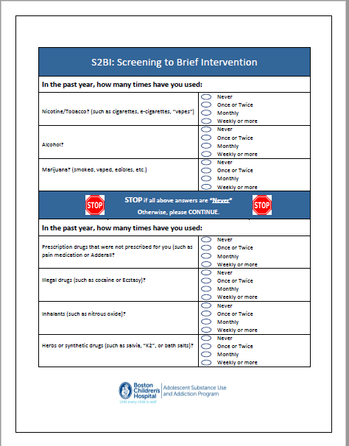
Notes:
This is a sample of what the S2BI might look like on paper – we can send this for their use if they would like it as a resource

Slide 12
S2BI
Use FREQUENCY
to assess RISK

Slide 13
Sensitivity/Specificity of S2BI
CIDI-SAM interview vs. screen frequency item for detecting a substance use disorder; N=215.
Criterion Standard Dx | Screen Frequency | Sensitivity | Specificity
Any SUD | > Monthly use | 90% | 94%
Severe SUD | > Weekly use | 100% | 94%
Levy, S. Ziemnik, R., Shrier, L., Sherritt, L., Spalding, A. (2013). Using a brief assessment tool to identify substance use disorders in teens. AMERSA 37th Annual National Conference, Bethesda, MD.
Notes:
This slide demonstrates the sensitivity and specificity of our SINGLE FREQUENCY QUESTION for detecting any substance use disorder and severe substance use disorder compared to a gold standard interview called the CIDI SAM. Both the accuracy of sensitivity and specificity were very high (90-100% for all categories). These ranges were similar for alcohol and marijuana which are not shown here for the sake of time.

Slide 14
DSM-5 Criteria for Substance Use Disorders
1 | Use in larger amounts or for longer periods of time than intended | Severity is designated according to the number of symptoms endorsed: 0 - 1: No diagnosis 2 - 3: mild SUD 4 -5 : moderate SUD 6 or more: Severe SUD
2 | Persistent desire or unsuccessful efforts to cut down or quit.
3 | Excessive time spent using, recovering from use, or trying to obtain substance
4 | Craving
5 | Failure to fulfill major obligations
6 | Continued use despite social or interpersonal problems
7 | Important activities given up or reduced
8 | Recurrent use in physically hazardous situations
9 | Continued use despite knowledge of physical or psychological problems
10 | Tolerance
11 | Withdrawal
American Psychiatric Association. (2013). Diagnostic and statistical manual of mental disorders (5th ed.). Arlington, VA: American Psychiatric Publishing.
Notes:
This is just a reference slide to share that the S2BI results are structured based on the DSM criteria. I usually just point out who mild, moderate, and severe SUD are determined (the column on the right of the slide)

Slide 15
S2BI In the past year, how many times have you used
Tobacco/Nicotine? (such as cigarettes, e-cigarettes, “vapes”) Alcohol? Marijuana?
No substance use
No substance use disorder (SUD)
Mild/moderate SUD
Severe SUD
Notes:
This shows the correlation between the S2BI frequency answers and their correlation to the different substance use categories
I highlight that for patients between 12-17, there is empirical correlation between Monthly use of a substance and a mild or moderate SUD and for those who report weekly use there is a correlation to a severe SUD
A quick and easy way to assess where they are on the substance use spectrum

Slide 16
Severe SUD
Mild/
Moderate SUD
No SUD
No Use
Notes:
Based on where they are on the substance use spectrum, there is an intervention for each category including No Use (more detail on next slide)
Adolescent Substance Abuse: New Strategies for Primary Care
16

Slide 17
How many times in the past year have you used:
Tobacco/Nicotine? Alcohol? Marijuana?
Prescription drugs? Inhalants? Illegal Drugs?
NO USE |  | ONCE OR TWICE |  | MONTHLY USE |  | WEEKLY USE
POSITIVE REINFORCEMENT |  | ASK FOLLOW-UP S2BI QUESTIONS |  | ASK FOLLOW-UP S2BI QUESTIONS
 |  | BRIEF ADVICE |  | MOTIVATIONAL INTERVENTION: ASSESS FOR PROBLEMS, ADVISE TO QUIT, MAKE A PLAN
 |  |  |  | REDUCE USE & RISKY BEHAVIORS |  | REDUCE USE & RISKY BEHAVIORS & REFERRAL TO TREATMENT
Notes:
The American Academy of Pediatrics has proposed an intervention strategy which aligns with DSM-V diagnoses. Kids who are abstinent receive positive feedback, those without a substance use disorder receive very brief advice, those with a mild or moderate substance use disorder receive a motivational based brief intervention and those with severe SUD also receive a referral and medications can be considered. Based on AAP guidelines, we designed a screen that triages adolescents into 4 “actionable” risk categories.
This is the algorithm that can be followed based on screening results
More details on next slide

Slide 18
Intervention Goals
No Use – positive reinforcement to delay initiation
No SUD – brief advice to encourage cessation
Mild/Moderate SUD – motivational intervention to encourage cessation or reduce use
Severe SUD – motivational intervention to stop or reduce use/risky behaviors (may require HLOC); Adolescents with nicotine, alcohol or opioid addiction may also benefit from medications

Slide 19


Slide 20


S2BI Screen - Computer-based (NIDA)
S2BI Toolkit (MCPAP)
**Screening and interventions are accurate; language is outdated
Notes:
The blue text are hyperlinks that they can access (you can send them this slideshow for their reference)
“language is outdated” – This was written prior to shifts in much of our language – for example, we no longer use terms like abuse and dependence which are highly stigmatizing but this resource has not been updated (I believe there is a plan to do this)

Slide 21
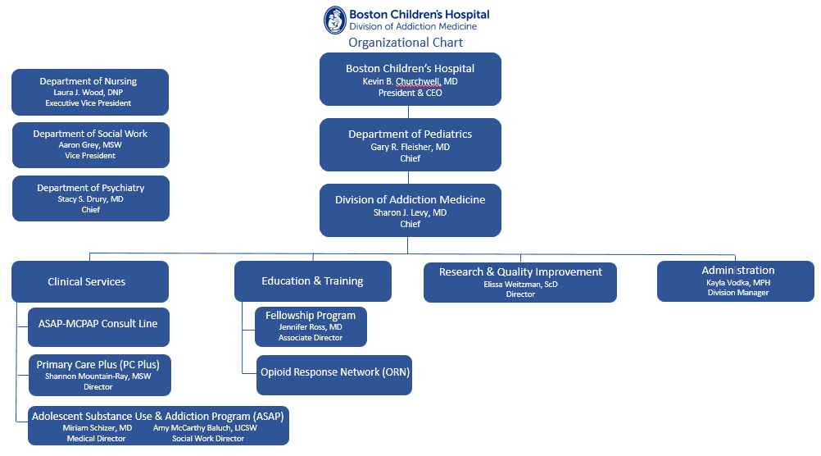


Slide 22
Adolescent Substance Use and Addiction Program (ASAP)
Division of Addiction Medicine
Boston Children’s Hospital
Outpatient Clinic:
  Multi-disciplinary team
  Hospital-based (in-person and virtual care) – Boston and Waltham
  Outpatient treatment – “from experimentation to addiction”
Comprehensive substance use evaluation | Clinical Drug Testing
Medications for substance use disorders | Group Therapy
Individual Substance Use Counseling | Parent Guidance
Psychopharmacology

Slide 23
Primary Care Plus (PC Plus)
Division of Addiction Medicine
Boston Children’s Hospital
  Collaborative Care Program:
  Outpatient treatment – “from experimentation to addiction”
    provides virtual care for primary care patients who may have co-occurring substance use and behavioral health concerns
    PC Plus social worker serves as a collaborative member of the multi-disciplinary primary care team
  Addiction Medicine Specialists provide support and guidance to primary care providers

Slide 24
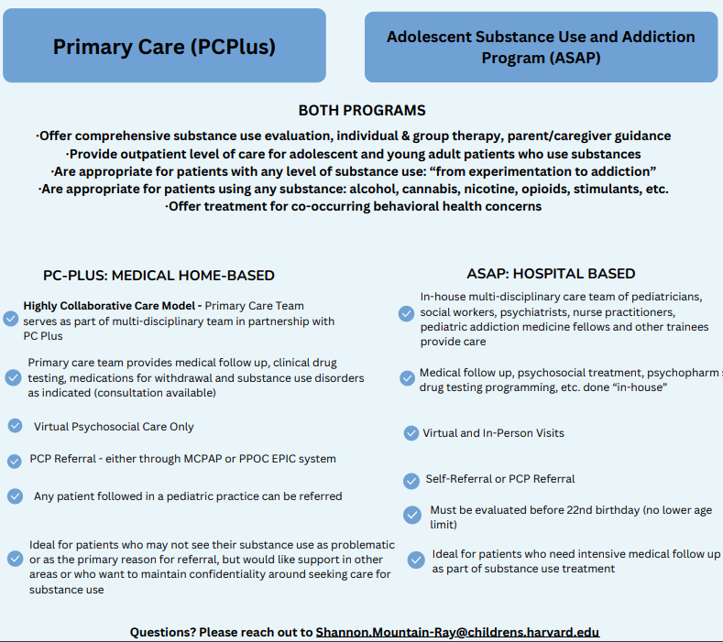

Slide 25
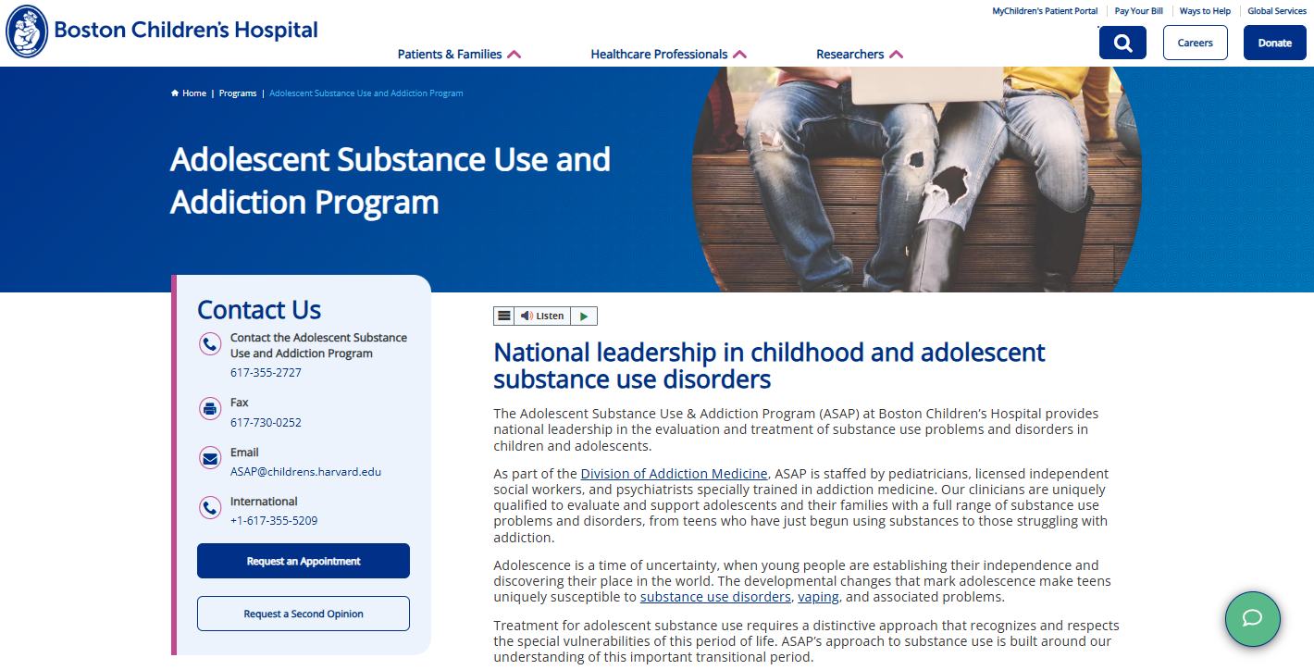
How to Refer to ASAP
https://www.childrenshospital.org/programs/adolescent-substance-use-and-addiction-program

Slide 26
Connecting with PC Plus
We recommend practices engage in a time-limited onboarding process with PC Plus
  Initial orientation for practice staff and 2 trainings
    Introduction to Adolescent Substance Use (45-60 min)
    Screening & Referrals (45-60 min)
  3-6 check-in meetings in the first year (15-20 min/each)
  *Structure of the onboarding process can be tailored to meet the needs of each individual practice

Slide 27
Other Practice Supports:
Access to practice-specific report on substance use screening results
Referral Updates
Clinical Progress Notes
Customized Live Trainings (virtual or in-person) as requested by the practice

Slide 28
What is an appropriate referral?
Any patient who screened positive or reported substance use in the last year
Patients do not need to believe that their substance use is problematic, want to make a change or be their primary reason for seeking support.
  We will “meet them where they are” and focus on the needs/goals they identify while integrating substance use education, prevention and treatment where applicable.

Slide 29
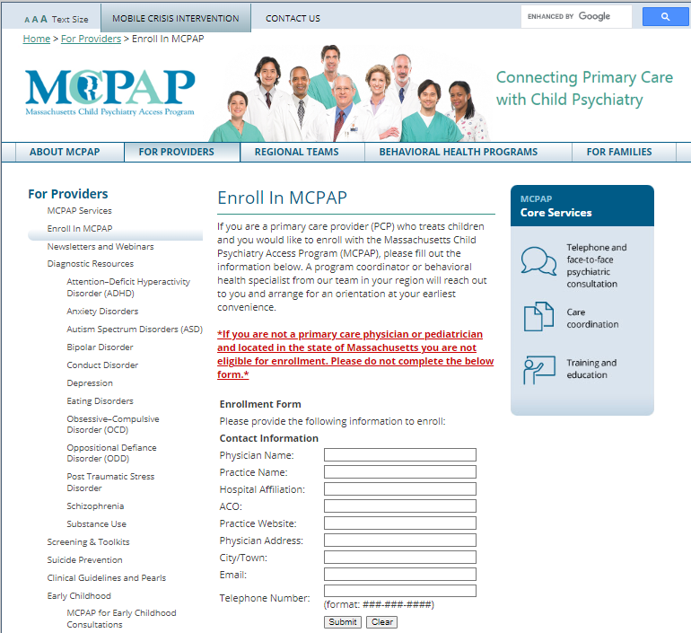
How Do I Refer to PC Plus?
Enroll in the Massachusetts Child Psychiatry Access Program (MCPAP)
https://www.mcpap.com/Provider/EnrollInMcPAP.aspx

Slide 30
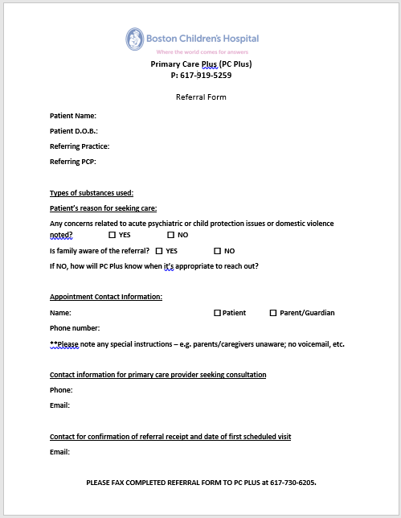
Making A Referral
Once enrolled in MCPAP, you can fax referral to 617-730-6205
Please ensure your referral includes all necessary information
Referral Form available (email: PCPlus@childrens.harvard.edu)

Slide 31
Referral Information Needed
  Types of substances used and patient’s reason for seeking care
  Any concerns related to acute psychiatric or child protection issues or domestic violence noted
  Is family aware of the referral? (If not, how will PC Plus know when it’s appropriate to reach out?)
  Appointment Contact Information (Name & phone number)
  Please note:
    Is this patient or parent/guardians contact information
    Any special instructions – e.g. caregivers unaware; no voicemail, etc.)
  Contact information for primary care provider seeking consultation
  Email address to receive confirmation that referral was received by PC Plus and date of first scheduled visit

Slide 32
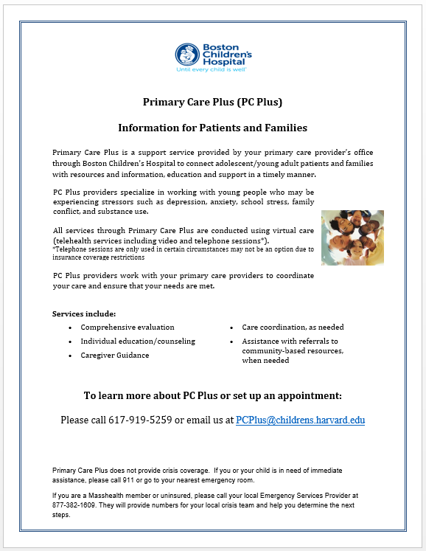
Making a Referral
Provide “PC Plus Information Sheet to Patient/Families
Includes a brief description of services offered and contact information for patients/families to set up appointments
Will still require a referral from PCP should patient/family decide participate

Slide 33
How to Contact PC Plus:
Email: PCPlus@childrens.harvard.edu
Phone: 617-919-5259
Fax: (617) 730-6205
Shannon.Mountain-Ray@childrens.harvard.edu

Slide 34
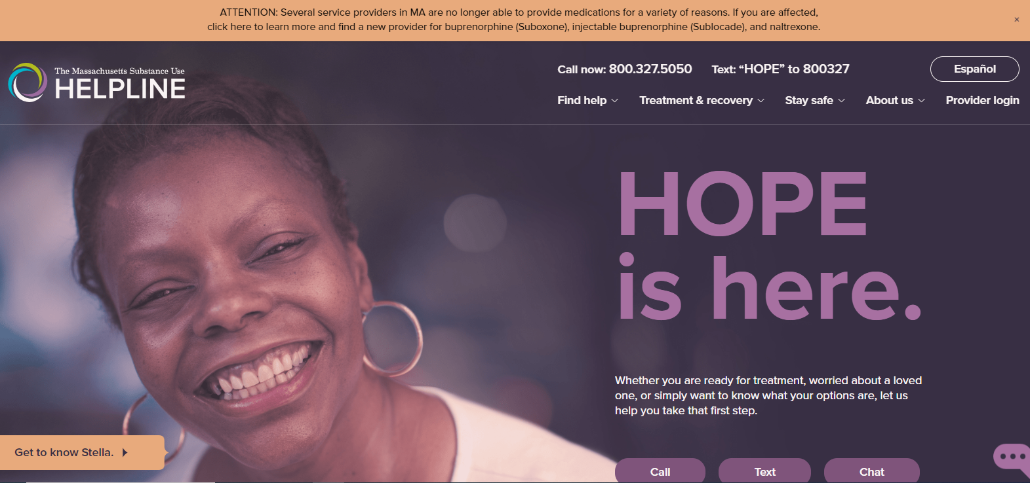
https://helplinema.org/
Notes:
BSAS helpline – an incredible resource; highly recommend calling if able (versus using the web-based treatment locater – which is fine but I feel like I get better results when I call)

Slide 35
Please don’t hesitate to reach out!
Shannon Mountain-Ray, LICSW
Director of Integrated and Collaborative Care
Shannon.Mountain-Ray@childrens.harvard.edu
857-218-4334 (x84334)

Slide 36

Questions?

