Slide 1
May 22, 2025
Collaborative Care Model (CoCM):
Promoting Adoption in Massachusetts
Virna Little, PsyD, LCSW-r
Co-Founder, Concert Health
Co-Founder, Zero Overdose

Slide 2
Rising Mental Health Needs in Primary Care
Source: Rotenstein, L. S., Edwards, S. T., & Landon, B. E. (2023). Adult primary care physician visits increasingly address mental health concerns. Health Affairs, 42(2), 163-171. https://doi.org/10.1377/hlthaff.2022.00705

Slide 3
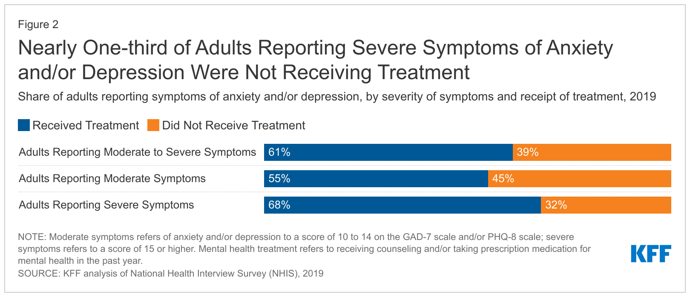
One Third of Adults in Need Receive No Treatment
Source: Panchal, N., Rae, M., Saunders, H., Cox, C., & Rudowitz, R. (2022, March 24). How does use of mental health care vary by demographics and health insurance coverage? Kaiser Family Foundation. https://www.kff.org/mental-health/issue-brief/how-does-use-of-mental-health-care-vary-by-demographics-and-health-insurance-coverage/

Slide 4
Higher Medical Costs of Patients with MHSUD Comorbidities
BH = Behavioral Health condition
MH = Mental Health condition
SUD = Substance Use Disorder
Source: Davenport S, Gray M, Melek S. “How do individuals with behavioral health conditions contribute to physical and total healthcare spending?” Milliman. Published August 13, 2020. https://www.milliman.com/-/media/milliman/pdfs/articles/millimanhigh-cost-patient-study-2020.ashx

Slide 5
Leveraging the Primary Care System
1 in 5 Massachusetts residents experience a Mental Health and/or Substance Use (MHSUD) Condition annually; only half receive care, often waiting until a condition is more serious to access specialty MHSUD care.
The average gap between diagnosis of a Mental Health condition and treatment is 11 years.
Patients with MHSUD and co-occurring medical conditions are the costliest to treat.
Most office-based MHSUD care is provided, and most psychiatric drugs are prescribed, by primary care providers (PCPs).
Primary care is the only source of MHSUD care available for many Americans.
Patients prefer to receive MHSUD care services in the primary care setting.
A large majority of patients who die by suicide have visited a primary care provider in the prior year, with almost half having done so in the prior month

Slide 6
MHSUD Care vs. Other Specialty Medical Care
For patients with cardiac conditions, the PCP:
Systematically screens for and measures cardiac symptoms
Provides care for non-acute patients
Refers more complex patients to a cardiologist for specialized care
There is no reason to treat MHSUDs differently.

Slide 7
The Collaborative Care Model (CoCM)
An evidence-based model within primary care that supports early identification, diagnosis, and treatment of MH conditions—helping to prevent symptom escalation and health crises
Supported by 100+ RCTs demonstrating improved health outcomes and reduced healthcare costs compared to usual care

Slide 8
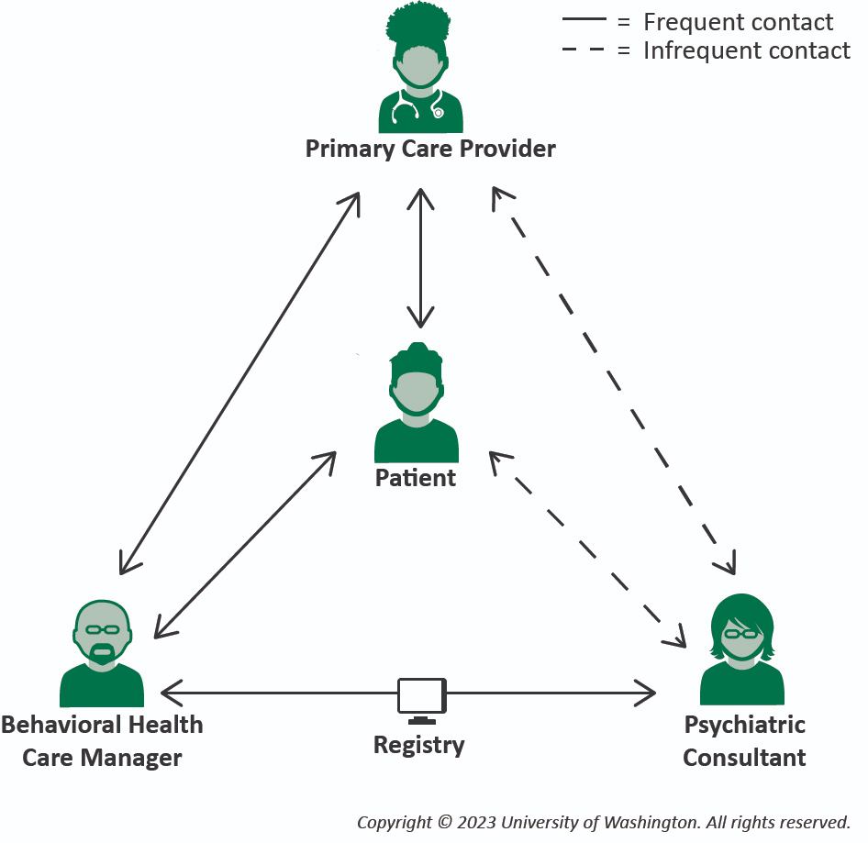
How CoCM Works
Addresses workforce shortages by expanding behavioral health capacity with care managers and consultative psychiatry for team-based care
Reduces PCP burnout by sharing care tasks and supporting complex mental health management
Improves outcomes across populations, including publicly insured, rural, underserved, and minority groups
Lyons et al. (2023), “Unique collaborative care system: Solution to the youth mental health crisis,” https://www.psychiatrictimes.com/view/unique-collaborative-care-system-solution-to-the-youth-mental-health-crisis;
Holmes & Chang (2022), “Effect of mental health collaborative care models on primary care provider outcomes: An integrative review,” https://doi.org/10.1093/fampra/cmac026;
Whitebird et al. (2017), “Clinician burnout and satisfaction with resources in caring for complex patients,” https://doi.org/10.1016/j.genhosppsych.2016.03.004;
Abah & Onwelumadu (2025), “Collaborative care for health equity: Integrated care for underserved populations,” https://www.intechopen.com/chapters/1194187

Slide 9
Low Cost MHSUD Intervention
CoCM patient episodes are billed once a month
Episodes can last 1 month or more than a year – however:
Over 80% of episodes are ≤6 months*
4.1 months is the length of an average patient episode*
This figure includes all patients, including those in care more than a year
Examples: Aggregate cost of 4-month episode**
Medicare, and Medicaid plans reimbursing at 100% of Medicare
$475 - $650
Commercial plans reimbursing at 150% of Medicare
$725 - $975
*Based on a large proprietary database of Medicaid, Medicare, and commercial patients
**Based on various combinations of billing codes 99492, 99493, 99494 and G2214

Slide 10
Tools for Measuring and Tracking Patient Outcomes
Tool | Description | Outcome Measures
PHQ-9 (Patient Health Questionnaire-9) | Assesses the severity of depression symptoms | 50% improvement or 10-point reduction in score
GAD-7 (General Anxiety Disorder-7) | Assesses the severity of anxiety symptoms | 50% improvement or 10-point reduction in score
PSC-17 (Pediatric Symptom Checklist) | A screening tool for identifying emotional, behavioral, and cognitive symptoms in children | Total Score: A change score of 6 or more indicates reliable change Subscales: Changes of 2 or more points indicate reliable change
PMQ-9 (Patient Mania Questionnaire-9) | A tool for evaluating symptoms of mood disorders, including mania | 50% reduction in mood disorder symptoms (combined PHQ-9 and PMQ-9 scores)
PCL-5 (PTSD Checklist for DSM-5) | A screening tool for assessing symptoms of PTSD | 50% or 20-point reduction in total score

Slide 11
Workforce Efficiency
CoCM Makes Efficient Use of Limited Psychiatrist Resources
One “full-time equivalent” psychiatric consultant can effectively impact MHSUD treatment for as many as 3-8 times more patients under CoCM than could be achieved through traditional 1:1 treatment.
Source: Penn Integrated Care Program, Penn Medicine, University of Pennsylvania. Courtesy of Matthew Press, MD.
Carlo, A. D., McNutt, C., & Talebi, H. (2024). Extending the clinical impact of behavioral health prescribing clinicians using the Collaborative Care Model (CoCM). Journal of General Internal Medicine, 39(8), 1525-1527. https://doi.org/10.1007/s11606-024-08649-2
Fortney, J. C., Bauer, A. M., Cerimele, J. M., Pyne, J. M., Pfeiffer, P., Heagerty, P. J., Hawrilenko, M., Zielinski, M. J., Kaysen, D., Bowen, D. J., Moore, D. L., Ferro, L., Metzger, K., Shushan, S., Hafer, E., Nolan, J. P., Dalack, G. W., & Unützer, J. (2021). Comparison of teleintegrated care and telereferral care for treating complex psychiatric disorders in primary care: A pragmatic randomized comparative effectiveness trial. JAMA Psychiatry, 78(11), 1189-1199. https://doi.org/10.1001/jamapsychiatry.2021.2318

Slide 12
Patient Outcomes
Measure | Improvement Rate
Review of Score at 90 Days 50% or 10-point reduction on PHQ-9 or GAD-7 | 47%
Review of Score at 120 Days 50% or 10-point reduction on PHQ-9 or GAD-7 | 52%
Review of Patients Who Achieved Remission <5 on PHQ-9 or GAD-7 | 38%
Source: Concert Health. Based on 30,659 patient episodes over a 12-month period from January 1, 2024, to December 31, 2024.

Slide 13
Patient Outcomes
Source: Penn Integrated Care Program, Penn Medicine, University of Pennsylvania. Courtesy of Matthew Press, MD.

Slide 14
Patient Outcomes by Population
Women: 30% reduction in anxiety symptoms at 90 days
Adolescents: 59% (PHQ-9) and 51% (GAD-7) had ≥50% symptom reduction at 90 days; rose to 62% (PHQ-9) and 54% (GAD-7) by 120 days
Older adults: Depression scores dropped from 16.7 → 8.6 (moderately severe → mild)
Rural patients: 74-83% with moderate/severe depression improved by 90 days
Publicly insured: 33% of Medicaid patients and 40% of Medicare patients met PHQ-9/GAD-7 benchmarks at 90 days
Lee et al. (2023), ”The effectiveness of collaborative care in publicly insured populations,” https://doi.org/10.1353/hpu.2023.0042;
Standeven et al. (2023), “Reduction of anxiety symptoms among women within a collaborative care model and women’s health settings,” https://doi.org/10.1017/S1463423623000440;
Vanderwood, Joyner, & Little (2023), “The effectiveness of collaborative care delivered via telehealth in a pediatric primary care population,” https://doi.org/10.3389/fpsyt.2023.1240902;
Vanderwood, Joyner, & Little (2025), “Remotely delivered collaborative care effectively addresses anxiety and depression among rural adults”;
“Effectiveness of collaborative care in a geriatric primary care population” [Unpublished manuscript]

Slide 15
Treatment Outcomes by Modality in Depression and Anxiety
Patients receiving phone or video care had significantly better symptom reduction than those seen face-to-face
Video-based care resulted in the highest rates of improvement for anxiety and depression
Greater number of touchpoints and assessments in early treatment (first 90-120 days) were associated with improved outcomes
Image from concerthealth.com
Vanderwood, K., & Little, V. (In Progress)

Slide 16
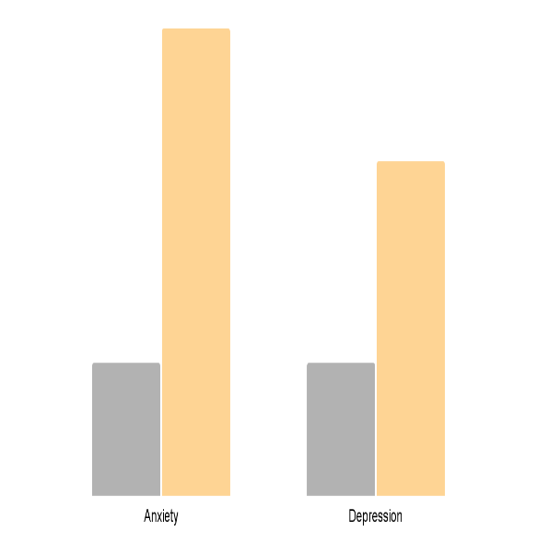
Clinical Variables for Successful Depression and Anxiety Treatment
More clinical touchpoints were associated with increased odds of improvement for both anxiety and depression
Shorter appointments (average touchpoint time) appeared to be more effective, suggesting brief, focused visits improve outcomes
Odds of Successful Discharge (High Touchpoints)
↑ 3.5
↑ 2.6
Anxiety Depression
Walker et al. (2024), “Factors influencing virtual collaborative care outcomes for depression and anxiety,” https://doi.org/10.4103/jfmpc.jfmpc_1493_23;
Hardy et al. (2024), “Clinical variables associated with successful treatment of depression or anxiety in Collaborative Care,” https://doi.org/10.1007/s11414-024-09892-5

Slide 17
Treatment Response/Remission Predictors in Severe Depression
Collaborative Care was equally effective for patients with severe depression (PHQ-9 > 20) as for those with moderate depression, when controlling for other factors
Image from concerthealth.com
Walker, C., Little, V., & Lyons, J. (In Progress)

Slide 18
Impact on Suicide Risk, Attempts and Deaths:
Three “Real World” Studies in Primary Care
Source: Bowman Family Foundation, 2025

Slide 19
Suicide Risk Reduction: Concert Health Study
(Study Period: 11/21 - 11/23)
EXCERPTS:
“The impact of “dose” is a key finding—patients enrolled for one month or less were most likely to see no change in their risk flag. On the other hand, patients enrolled in care for at least half a year were far more likely to see an improvement in their risk flag—76% of such patients experienced an improvement.” “
Similar to months enrolled, patients that received more clinical touchpoints were more likely to see an improvement in their suicide risk score—83% of patients who received 15 or more touchpoints demonstrated improvement.”
“The analysis revealed no statistical association between age category and treatment outcome. This finding suggests that the Concert Suicide Care Pathway may be effective across all age groups, indicating its broad applicability and potential effectiveness regardless of age.”
Source: Little et. al., “Addressing suicide risk: A study of dose response in collaborative care,” 2024

Slide 20
Suicide Risk Reduction: University of Pennsylvania Health System Study
(Study Period: 2018 - 2022)
EXCERPTS:
“…PIC [CoCM at Penn] has since expanded to more than 35 urban and suburban primary care practices…”
“Among both patient groups, length of time in CoCM and number of sessions were each associated with patients were treated for over six months.”
“Importantly, we found that among patients with suicidal ideation at baseline, those identifying as Hispanic/ Latinx…had greater declines in depression and anxiety severity. Additionally, among patients without suicidal ideation at baseline, those identifying as Black…had significantly greater declines in depression severity. These findings complement a burgeoning literature showing that patients identifying as racial or ethnic minorities, including those identifying as Black or Latinx, show improved access to mental health care and clinical outcomes in CoCM. A recent review concluded that the evidence supporting the effectiveness of CoCM for mental health treatment among patients identifying as racial or ethnic minorities is larger than for any other intervention.”
Source: Khazanov et al., “Change in suicidal ideation, depression, and anxiety following collaborative care in the community,” 2024

Slide 21
Suicide Risk Reduction: Kaiser Permanente Study
(Study Period: 1/15 - 7/18)
EXCERPTS:
“…the objective of this study was to analyze the out comes of integrating SC [suicide care] in primary care, beginning with population-based screening for depression, followed by suicide risk assessment and collaborative safety planning.”
“…population-based SC was implemented at the same time as care for substance use (alcohol, cannabis, and other drug use) as part of a behavioral health integration initiative (detailed below). Before this initiative, the health system had no population-based screening or systematic follow-up for these conditions in primary care.”
“When patients reported some level of prior month intent or planning for a suicide attempt on the C-SSRS, primary care clinicians were instructed to connect patients with designated members of the care team for same-day safety planning. Licensed independent clinical social workers…were trained to function as integrated mental health clinicians, specifically to prioritize engaging at-risk patients in safety planning, as well as provide short-term counseling and linkage to specialty mental health and substance use treatment.”
Source: Angerhofer Richards et al., “Effectiveness of integrating suicide care in primary care,” 2024

Slide 22
Impact on Total Healthcare Costs
Source: Bowman Family Foundation, 2024

Slide 23
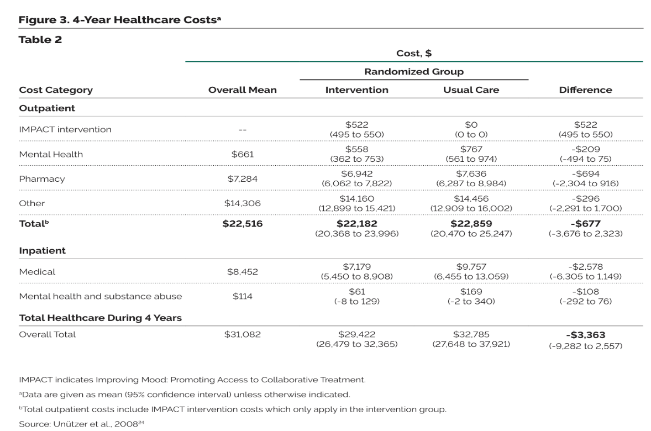
Cost Impact: IMPACT Study
(2008)
Source: Unutzer et al., "Long-term cost effects of collaborative care for late-life depression," 2013

Slide 24
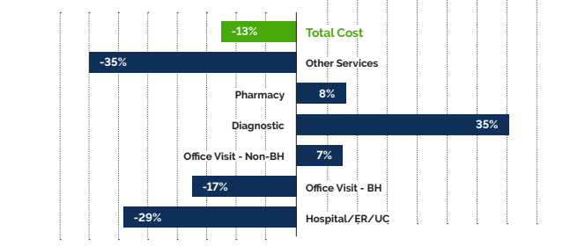
Cost Impact: Kaiser Permanente Study
(2015)
% Change in PMPM Costs for DCM Population vs. Comparison Group
Source: Kaiser Permanente. Previously unpublished information and data from a study undertaken in 2015 regarding total healthcare costs: “Collaborative Care Model Versus Treatment-As-Usual,” 2024

Slide 25
Cost Impact: UPenn/IBX Study
(2023)
During 12 months following initiation of CoCM, THCs were $29.35 lower pmpm (non-statistically significant) for CoCM patients versus matched patients receiving treatment as usual, despite the fact that CoCM patients received more mental health care (i.e., savings accrued in physical health care spending).
MHSUD Costs | $19.91 Higher for PIC Group
PIC Medical (CoCM) | $34.11 (PIC Group Only)
Non-MHSUD Costs | $72.46 Lower for PIC Group
Inpatient Costs * | $91.34 Lower for the PIC group
Total Healthcare Costs * | $29.35 Lower for PIC Group
*Non-statistically significant
Source: Wolk et al., "Impact of the collaborative care model on medical spending," 2023

Slide 26
CoCM Implementation –
Experiences and Outcomes

Slide 27
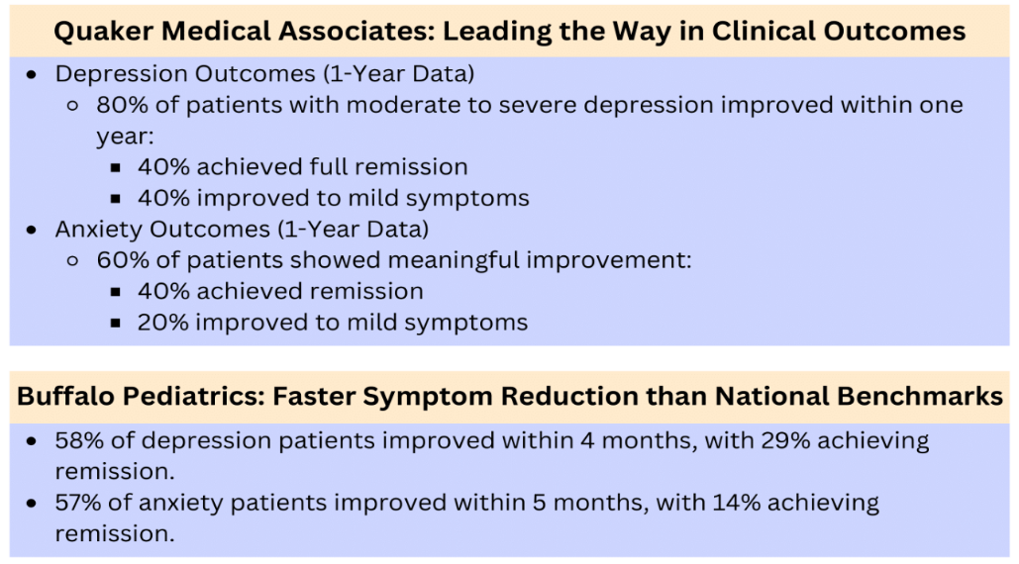
Clinical Case
“Collaborative Care is an outstanding example of what we are trying to accomplish in value-based care. It enhances the scope of preventative care provided in primary care settings, minimizes the unnecessary use of specialty care, reduces overall costs, and most importantly, improves care for our patients. —Larry Zielinski, CEO, Primary Care IPA
Source: Primary Care IPA

Slide 28
Financial Case
Source: Primary Care IPA

Slide 29
Massachusetts Stakeholder Engagement and Findings

Slide 30
MA Stakeholder Engagement
Thought & Policy Leaders
Payer Organizations
Health Care Providers
AIMS Center, U. Washington
Alliance for Patients
Blue Cross Blue Shield MA Foundation
Bowman Family Foundation
Concert Health
Dell Medical School
MA Association for Mental Health
Massachusetts Health Policy Commission
MetroWest Foundation
Meadows Mental Health Policy Institute (MMHPI)
National Council for Mental Well-Being
Network for Excellence in Health Innovation (NEHI)
The Goodness Web
Blue Cross Blue Shield of MA (BCBSMA)
BMC Health Plan
CHA Health Plan
Carelon Behavioral Health
Centers for Medicare & Medicaid Services (CMS)
Community Care Cooperative (C3)
Fallon Health
Massachusetts Association of Health Plans (MAHP)
Mass Behavioral Health Partnership (MBHP)
Mass General Brigham (MGB) Health Plan
MassHealth
Optum
Baystate Health
Beth Israel Lahey Health
Boston Children’s Hospital
Boston Medical Center
Cambridge Health Alliance
Children’s Hospital Boston
Family Practice Group of Arlington, MA
Massachusetts Behavioral Health Partnership (MBHP), a Carelon Behavioral Health Company
Massachusetts Child Psychiatry Access Program Massachusetts League of Community Health Centers
Mass General Brigham (MGB)
Tufts Medicine

Slide 31
MA Consensus on CoCM Opportunities
Payers, providers, and thought or policy leaders agreed on several points that would help overcome challenges to advance adoption of Collaborative Care:
Financial Support: Startup funds to cover initial costs and ensure practices do not lose money during ramp-up implementation.
Education and Training: Increasing awareness about CoCM’s value and benefits with focus on prevention and early intervention, diagnosis, and treatment.
Champions within Practices: Both a business champion and a primary care clinical champion are essential for initiating and sustaining CoCM.
Simplification of the CoCM Model: Avoiding over-complication in roles, billing, and credentialing processes. Better understanding of how much flexibility is allowable while still maintaining fidelity to core components of CoCM.
Integration with EHR Systems: Developing infrastructure to integrate CoCM platforms with existing electronic health records.

Slide 32
MA Consensus on CoCM Opportunities (continued)
Removal of Cost-Sharing: Encouraging broader adoption by eliminating patient cost-sharing for CoCM services.
Value of Peer Testimonials: Sharing success stories from peer-providers who have successfully implemented CoCM.
Technical and Financial Assistance: Providing TA and financial support to practices to underwrite CoCM implementation including billing, registry, training for practice transformation, recruitment of BH care manager and psychiatric consultation.
Workforce Development: Addressing the shortage of qualified behavioral health professionals. Clarify role of CoCM care manager. Increase access to psychiatrists.
State Government, Legislative, or Regulatory Support: Facilitating adoption through public endorsement of the CoCM model, supportive policies, payments, and regulations to incentivize CoCM adoption more widely.

Slide 33
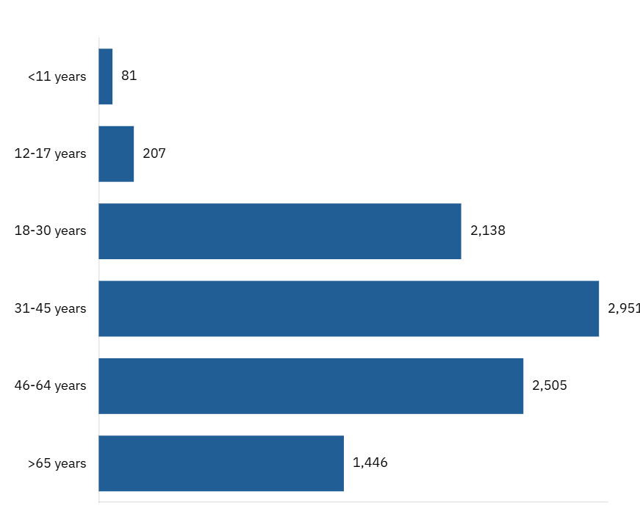
Massachusetts Population
By Age Group
Source: Concert Health

Slide 34
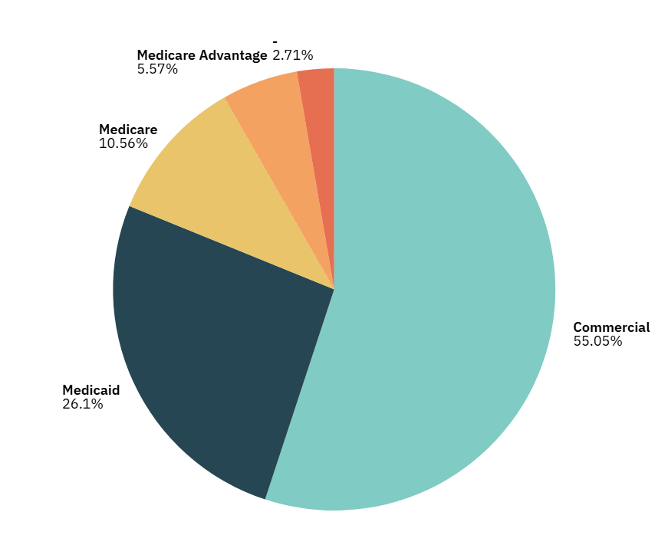
Massachusetts Population
By Insurance Type
Source: Concert Health

Slide 35
May 22, 2025
Collaborative Care Model (CoCM):
Promoting Adoption in Massachusetts
Virna Little, PsyD, LCSW-r
Co-Founder, Concert Health
Co-Founder, Zero Overdose

